Slide 1
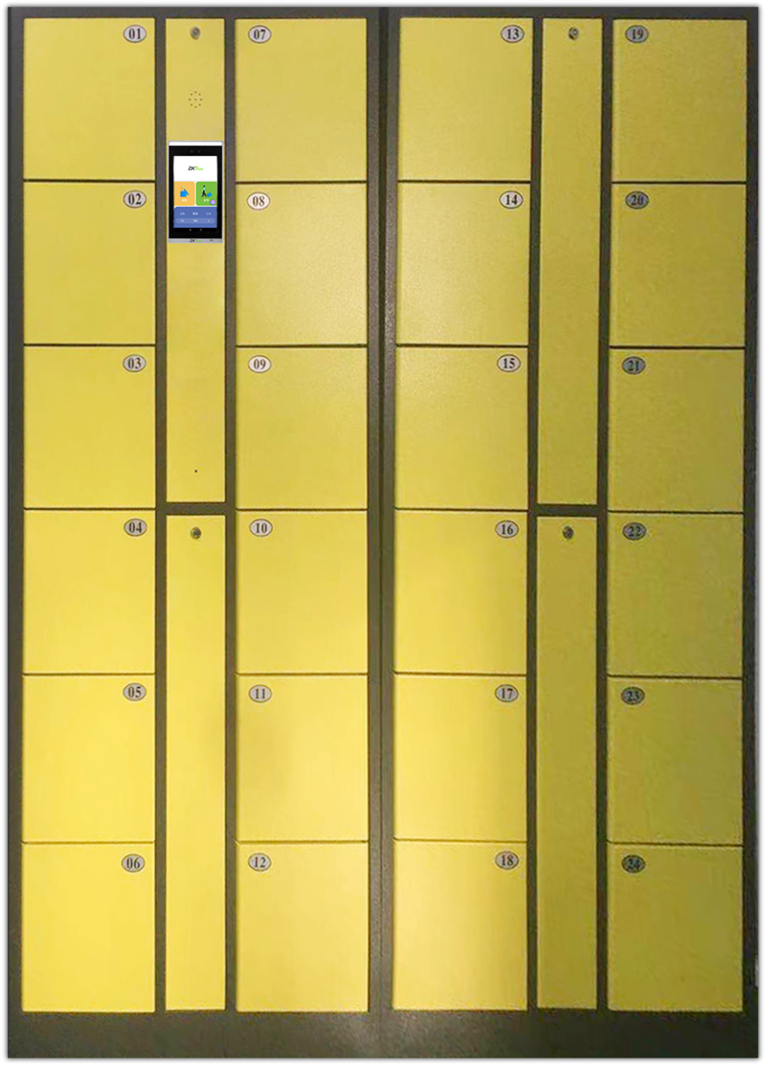
Intelligent Locker Solution Using Biometric Authentication
2021/9/27 ZKTeco’s Solution Department

Slide 2
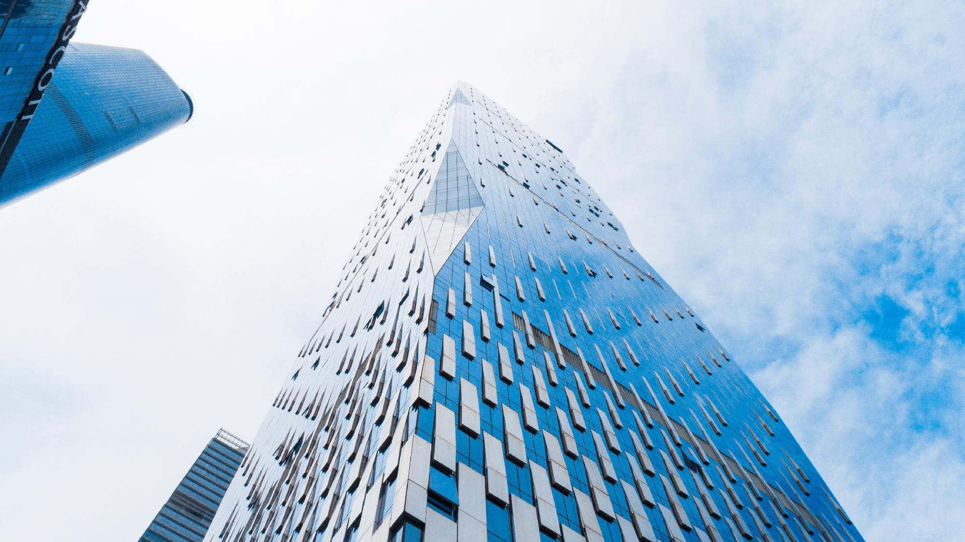

1
Solution Introduction
2
Product Introduction
Contents
3
FAQ

Slide 3
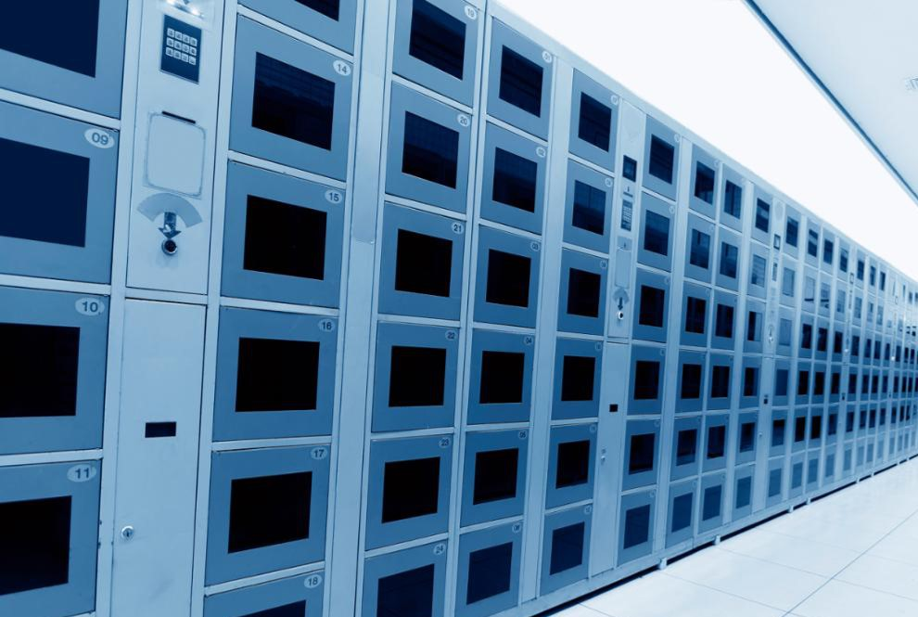
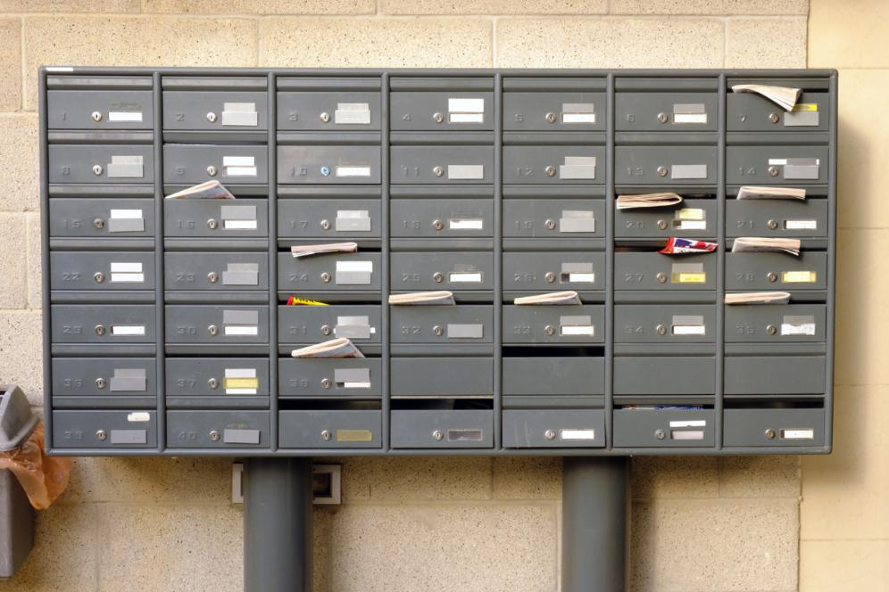
Solution Introduction
1
The Problem of trational Locker
Traditional Lockers usually require physical credentials, like receipts and keys, which are easily lost. That means it needs manual management.
Storage and pick-up history is not available if using traditional lockers.
Traditional mechanical lock is easy to be unlocked by thieves.

Slide 4
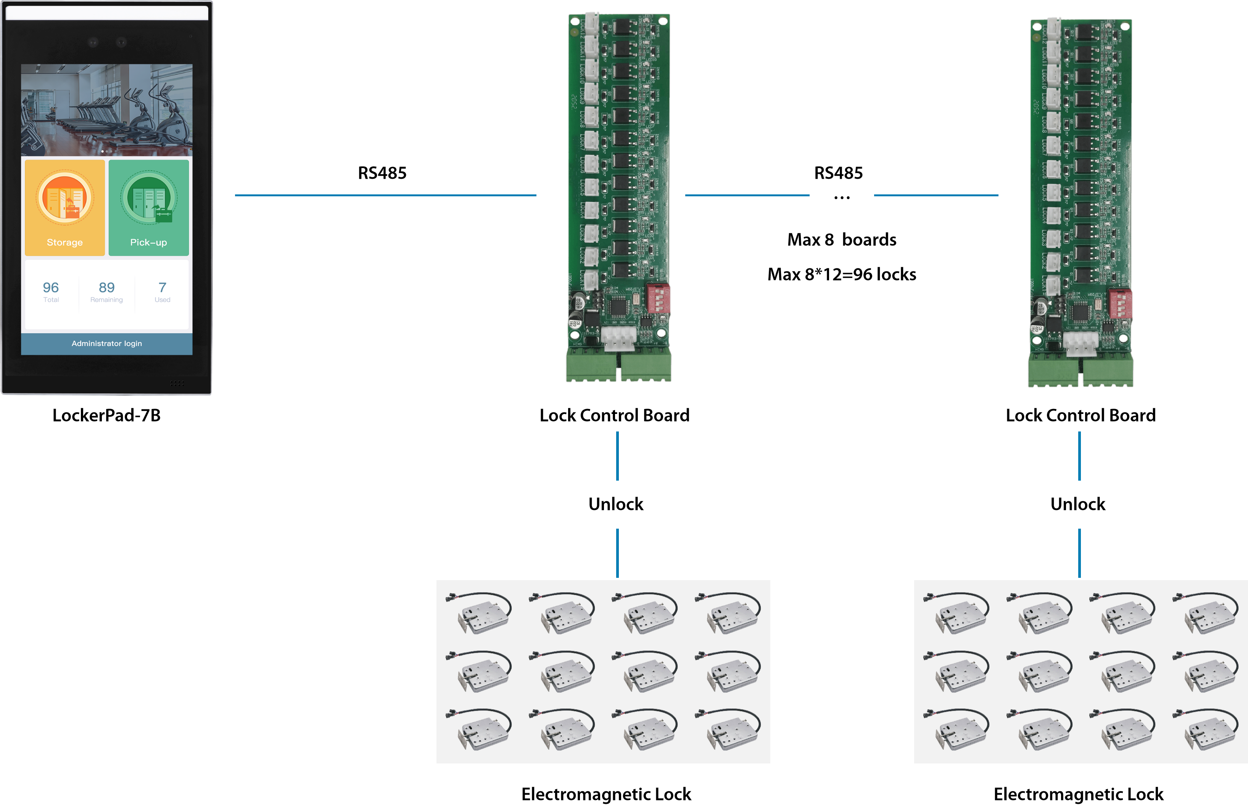
Architecture

Slide 5
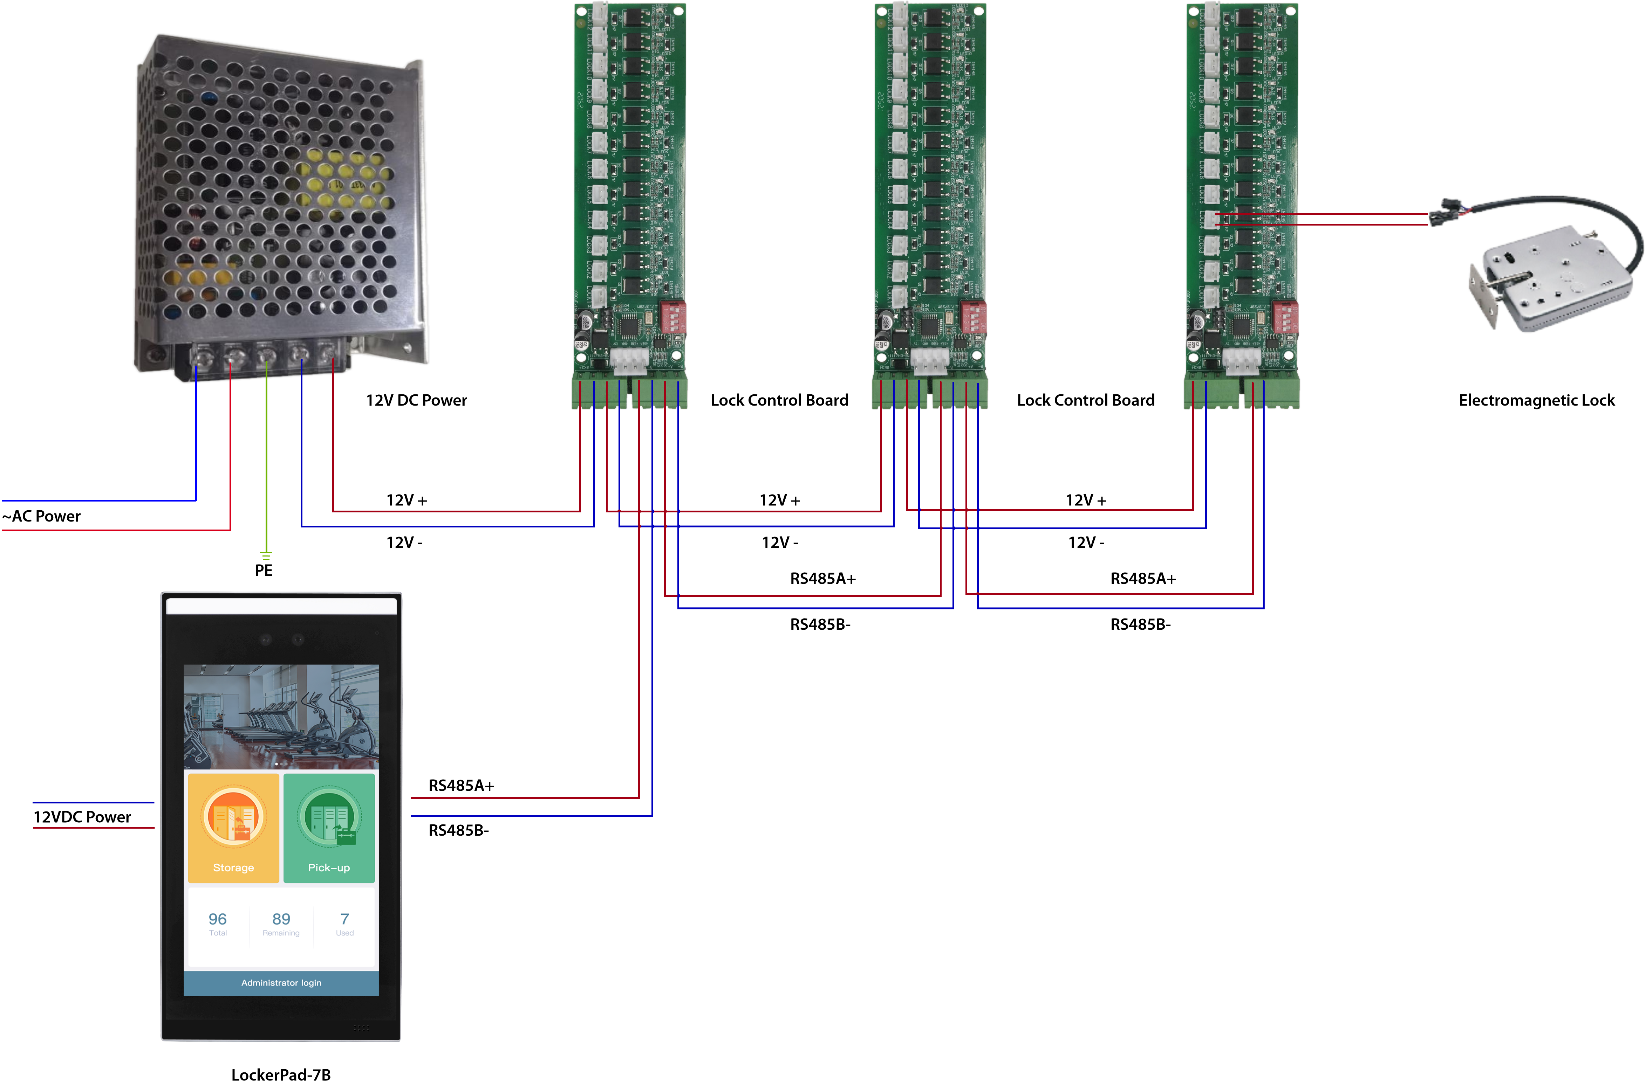
Line Diagram

Slide 6



Highlight
ZKTeco‘s Intelligent and Biometric Locker is designed for both internal users and temporary users. It is your new storage option in fitness centers, commercial and residential buildings.
Face / Card Verification: Intelligent and Biometric Locker is a smart storage terminal developed based on Facial Recognition technology developed by ZKTeco. Masks and beards would not affect the performance. The solution is compatible with Wiegand Card readers.
Personalization: We provide a user-defined number of cells. It supports a maximum of 96 cells, support three compartment sizes according to the client’s needs.
Configure Switch: We provide serveral switches to meet different situation need. Switch 1: Allow Visitor to use Switch 2: Allow Halfway Out Switch 3: Allow Multiple people use One Compartment

Slide 7



Highlight
ZKTeco‘s Intelligent and Biometric Locker is designed for both internal users and temporary users. It is your new storage option in fitness centers, commercial and residential buildings.
Anti-Counterfeiting: The Facial Recognition terminal is equipped with a smart binocular camera, which supports liveness detection, faster and more accurate recognition. It could effectively help reduce the risk of thieving. Thanks to the intelligent lighting design, the device has high adaptability under different lighting conditions.
Advertisements: It offers advertisement space on a 7-inch touch screen, improving business efficiency and helping in realization of business goals.
Storage and pick-up History: It could save up to 100,000 transactions of storage and pick-up, which is convenient for administrators to view the using details.

Slide 8
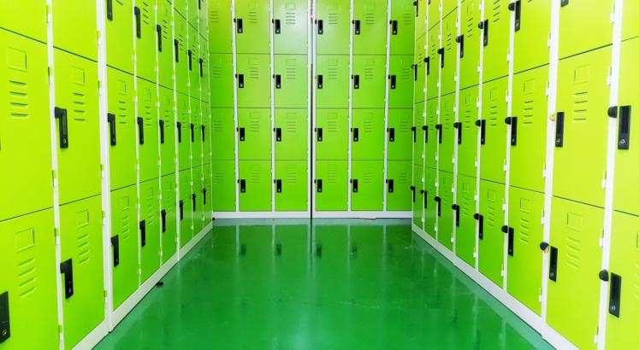
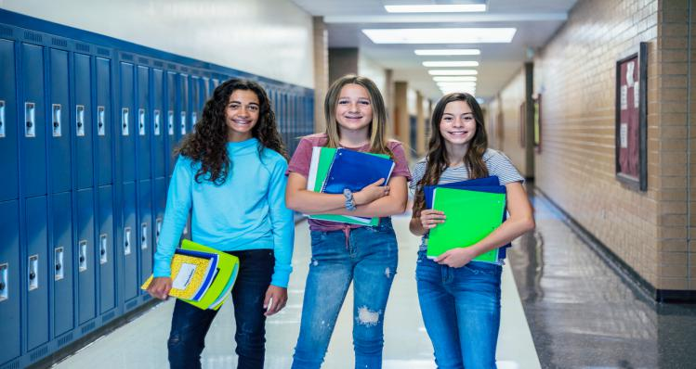
Applications: Fixed Users
Fixed User: Employee and Student
Fixed Compartment
Two modes: One User One Compartment and Multi-user One Compartment
Facial Recognition or Card Verification
Factory
School

Slide 9
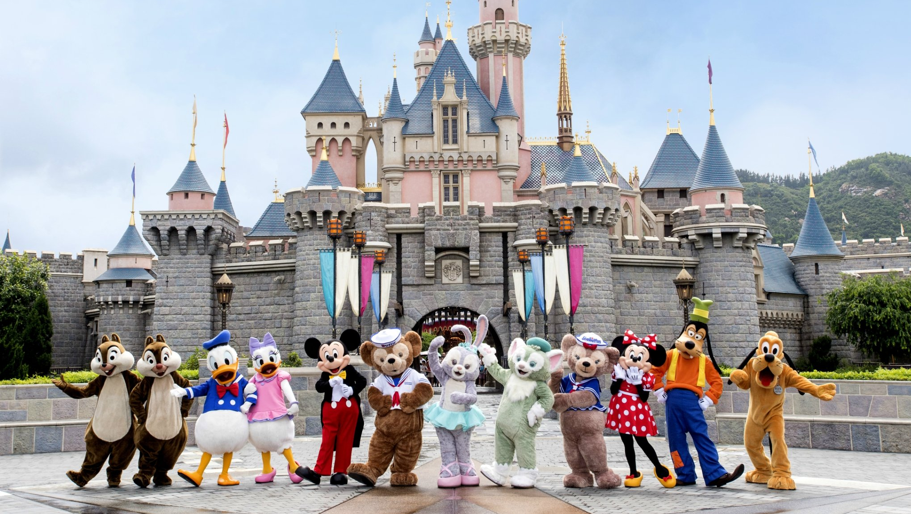
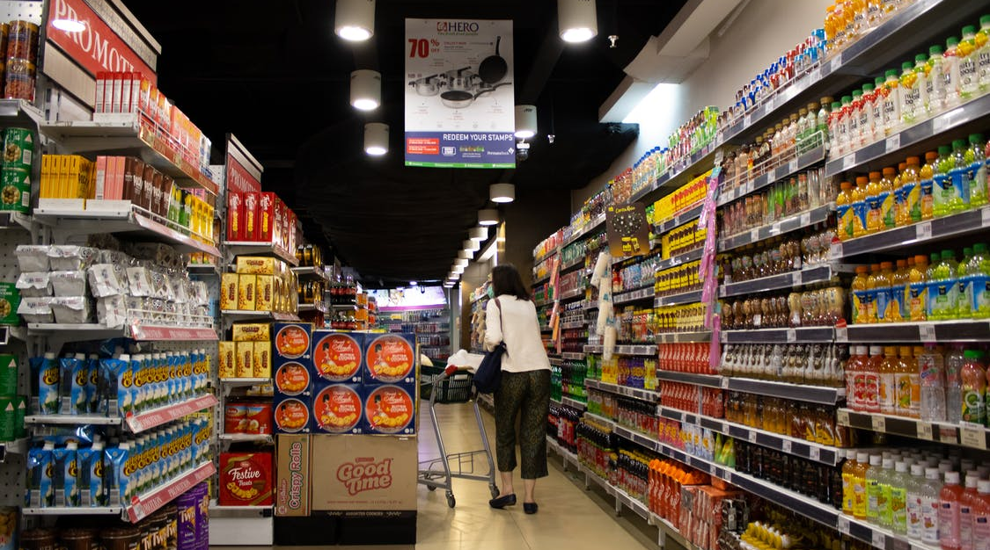
Applications: Temporary User
Temporary User: Tourist and Client
No Fixed Compartment, Temporary Random Compartment
Pick-up All or Halfway out
Facial Recognition
Amusement Park
Supermarket

Slide 10
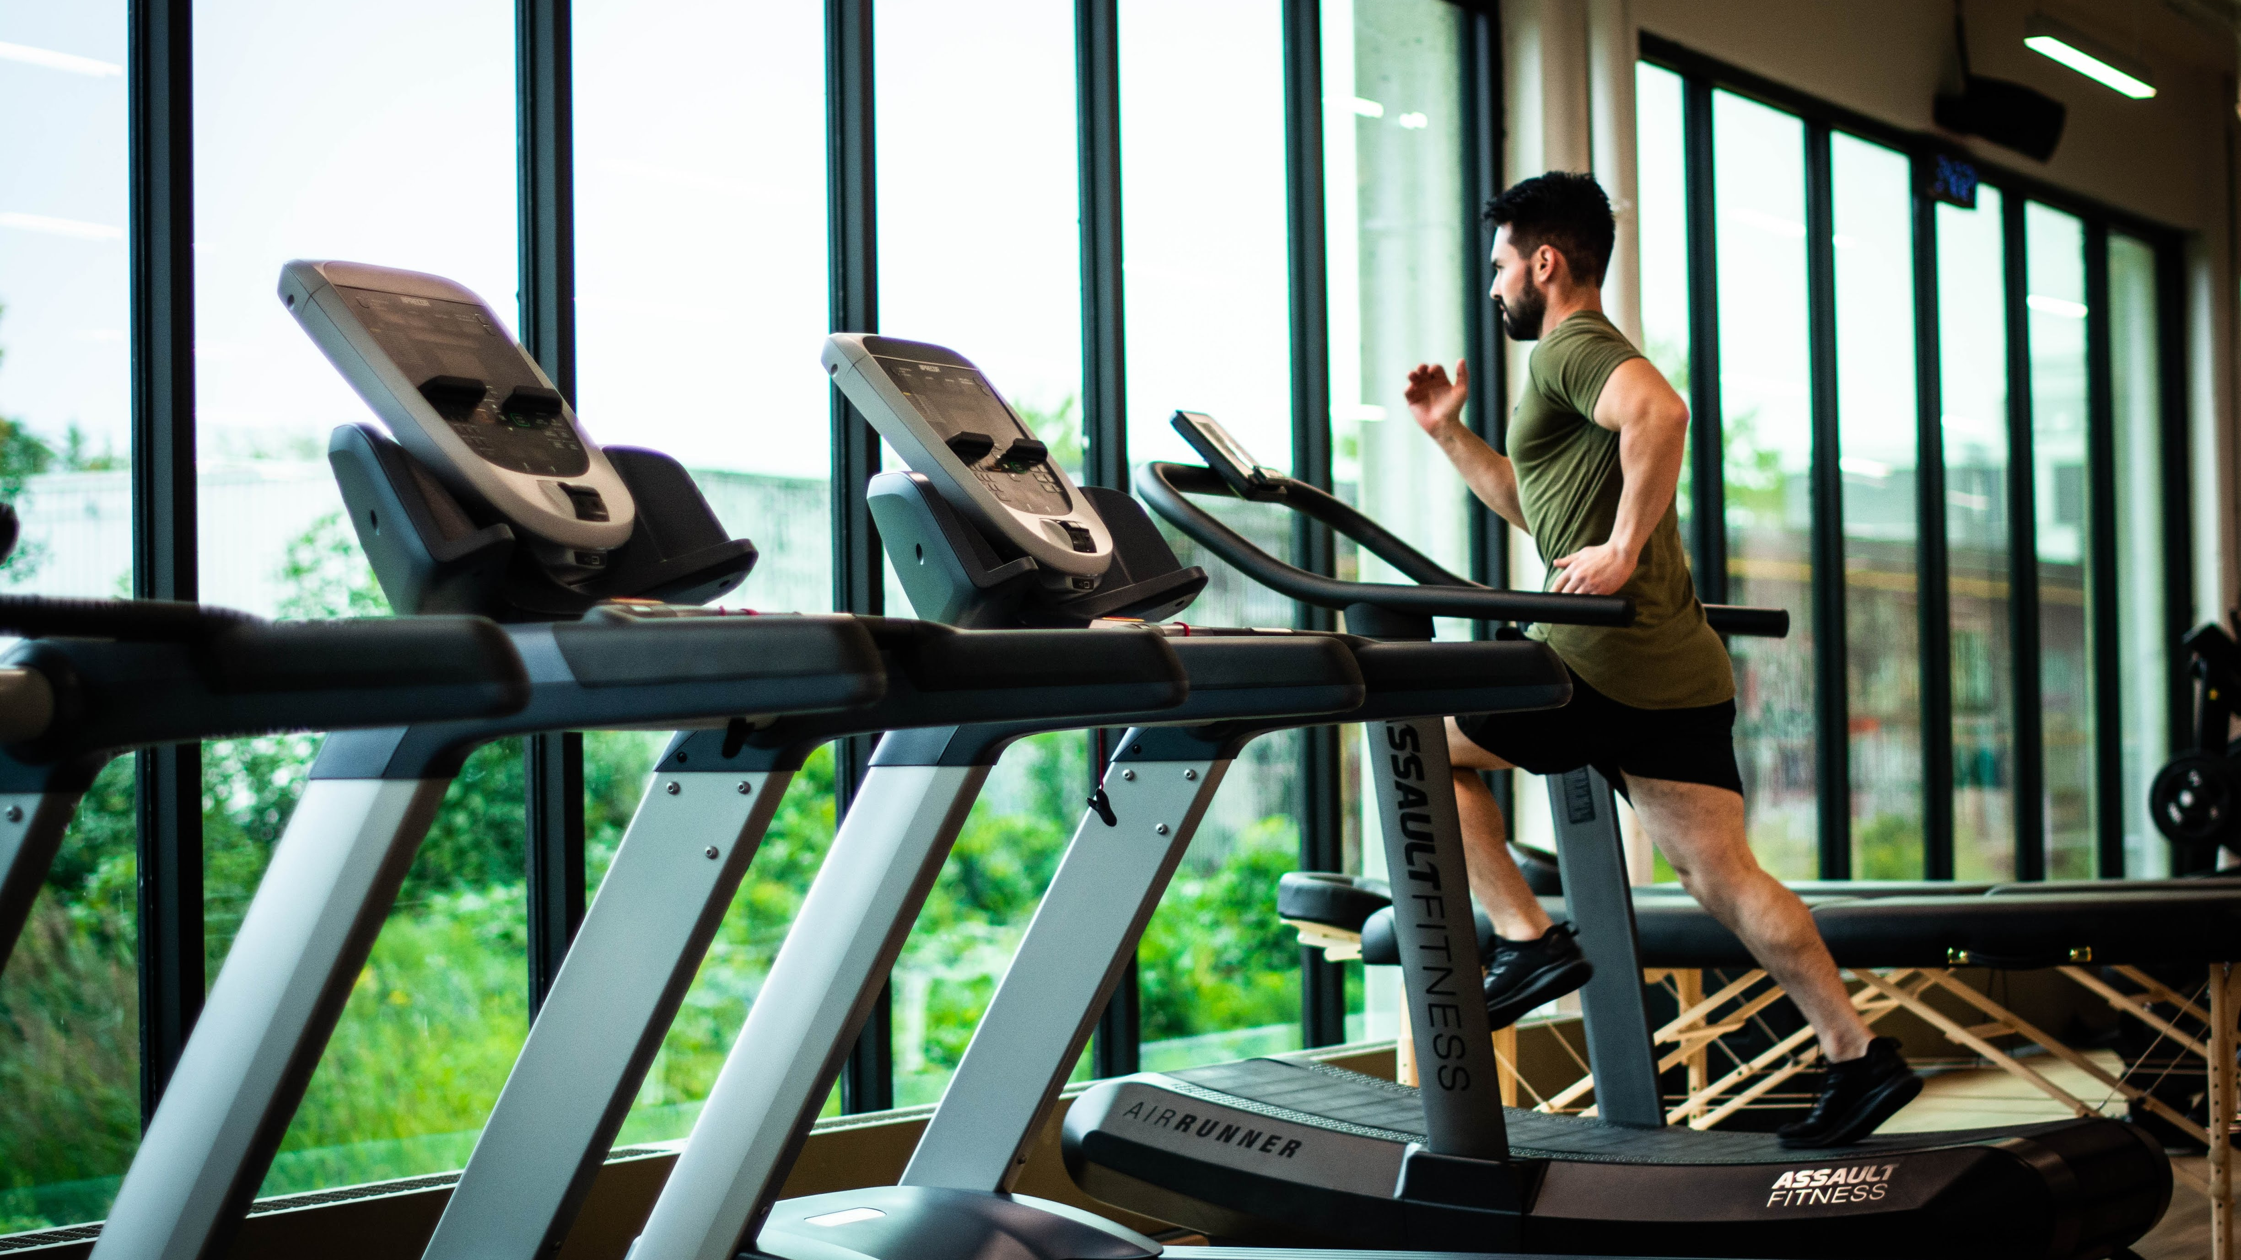
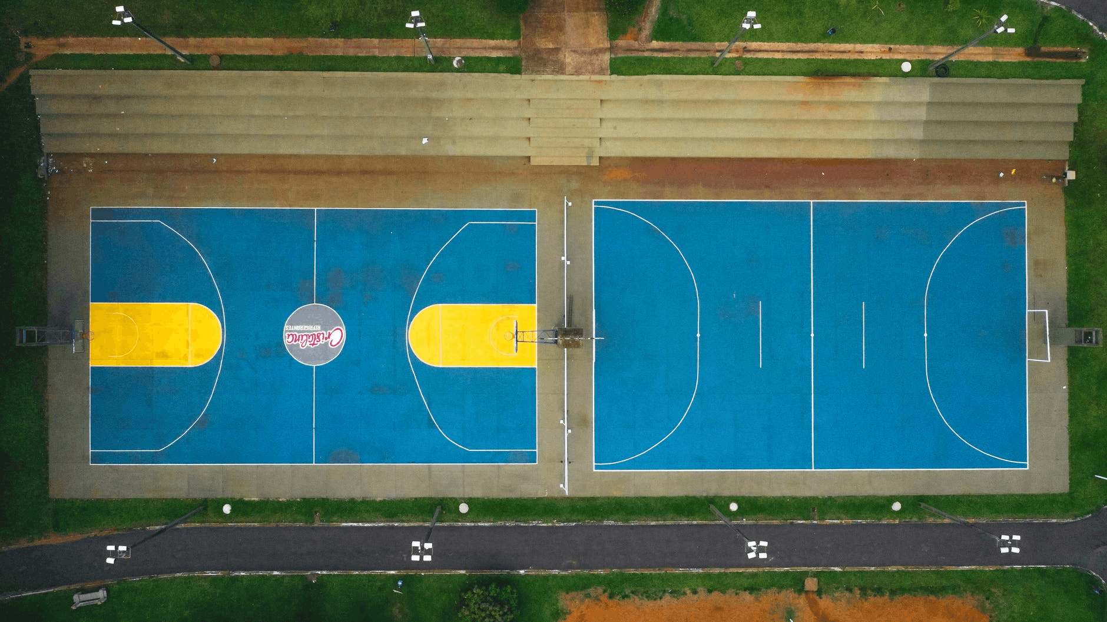
Applications: Fixed+Temporary User
Fixed+Temporary User: Staff and Customer
Fixed and Temporary Compartment
Multi-user One Compartment
Fixed Staff: Facial Recognition or Card Verification
Temporary Customer: Facial Recognition
Gym and Fitness
Sports Field

Slide 11
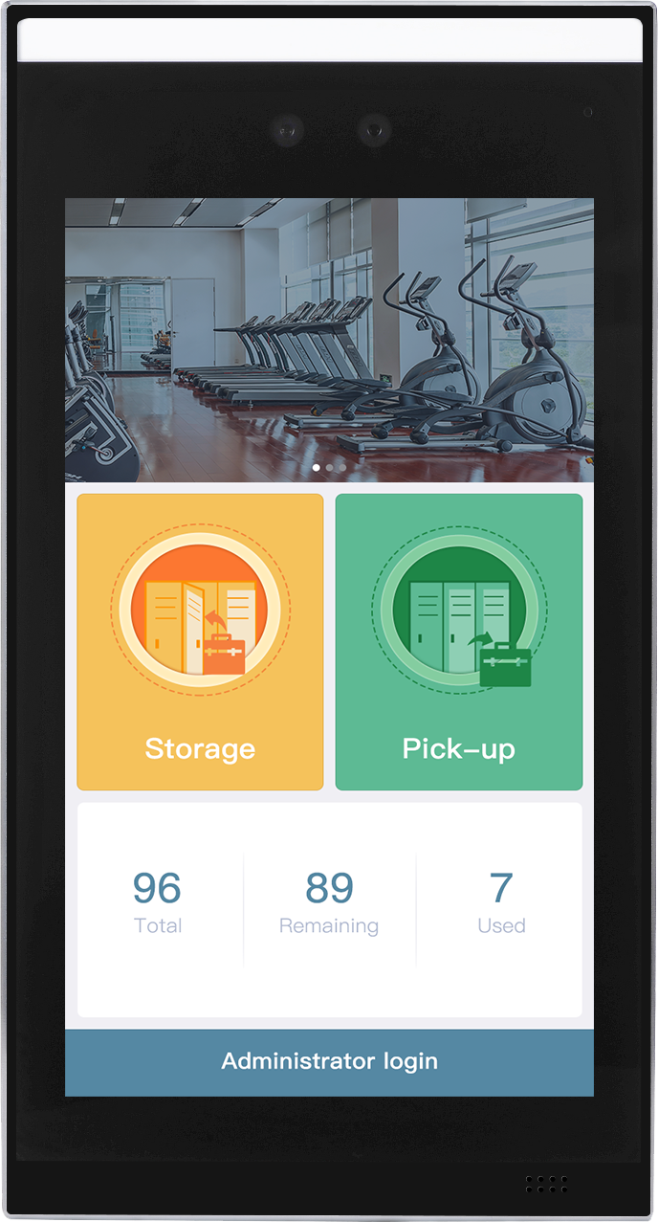
Product Introduction
2
LockerPad-7B is a locker solution core device based on ZKTeco face recognition and card recognition technology.
It communicates with the Lock Control Board through the RS485 protocol to control the unlocking of the electronic lock.
AD Area
Model | LockerPad-7B
LCD | 7-inch touch screen (1280 x 720 pixel)
Memory | 2G RAM / 16G ROM
User Capacity | 10,000
Regular User Capacity | 96
Verifation Method | Face, Card (External Wiegand Reader)
Storage
Pick-up
Locker Info
Administrator Login
LockerPad-7B is based on the Hardware of Facedepot-7B
LockerPad-7B

Slide 12
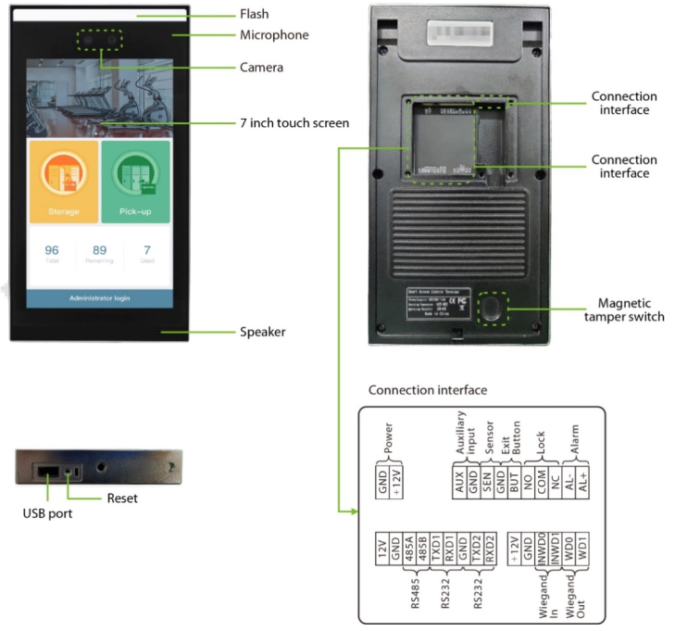
Product Introduction
2
The hardware of LockerPad-7B is same with Facedepot-7B

Slide 13
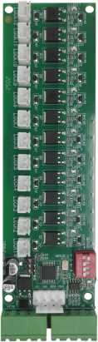
Product Introduction
2
One Lock Control Board has 12 control ports, each port could control one lock.
One Baord could work together with other 7 boards, that means one LockerPad-7B could connet with 8 boards through RS485 to control 96 locks.
Different Borad is set different address code by the Dial switch.
Control Port
Board ID | Lock Range | Switch 1 | Switch 2 | Switch 3 | Switch 4
1 | 1-12 | 1 | 0 | 0 | 0
2 | 13-24 | 0 | 1 | 0 | 0
3 | 25-36 | 1 | 1 | 0 | 0
4 | 37-48 | 0 | 0 | 1 | 0
5 | 49-60 | 1 | 0 | 1 | 0
6 | 61-72 | 0 | 1 | 1 | 0
7 | 73-84 | 1 | 1 | 1 | 0
8 | 85-96 | 0 | 0 | 0 | 1
Dial switch
Power
RS485
Lock Control Board

Slide 14
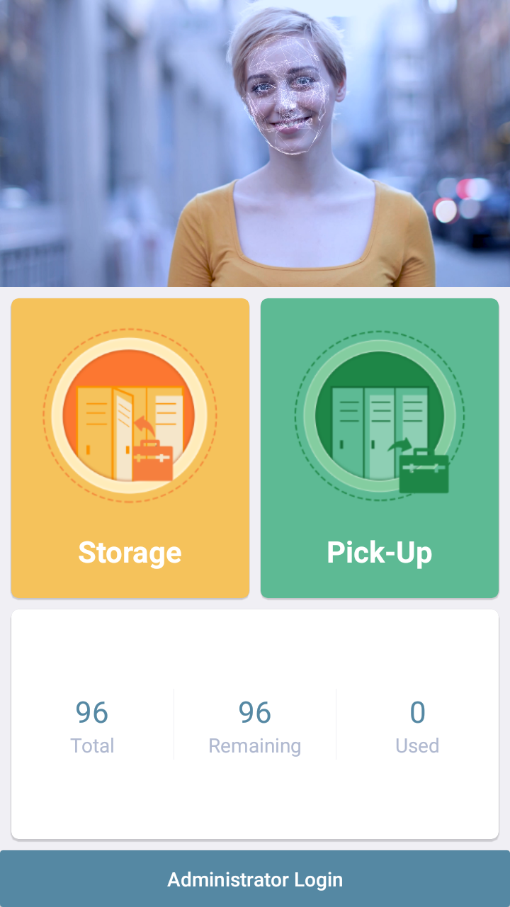
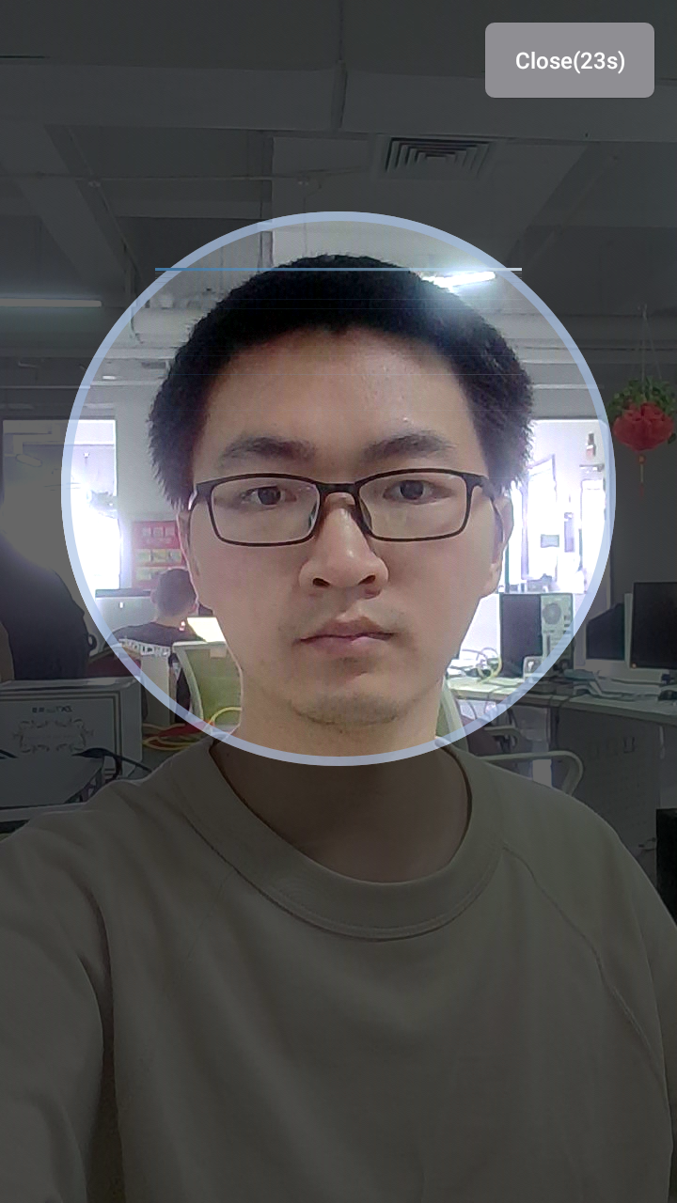
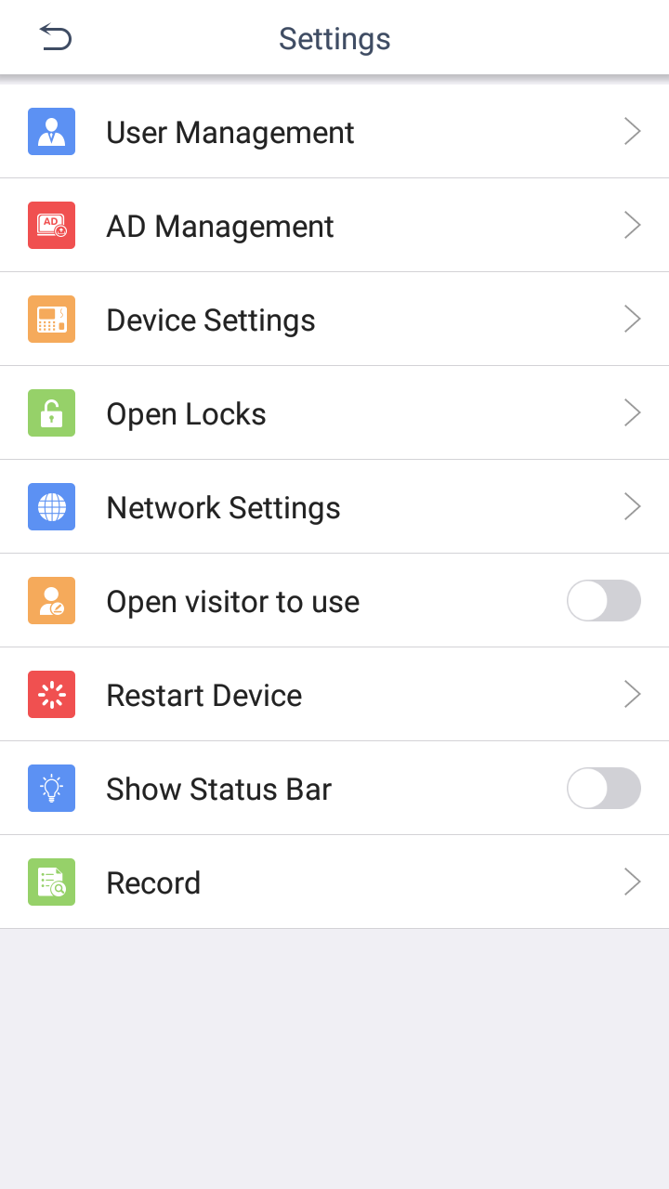
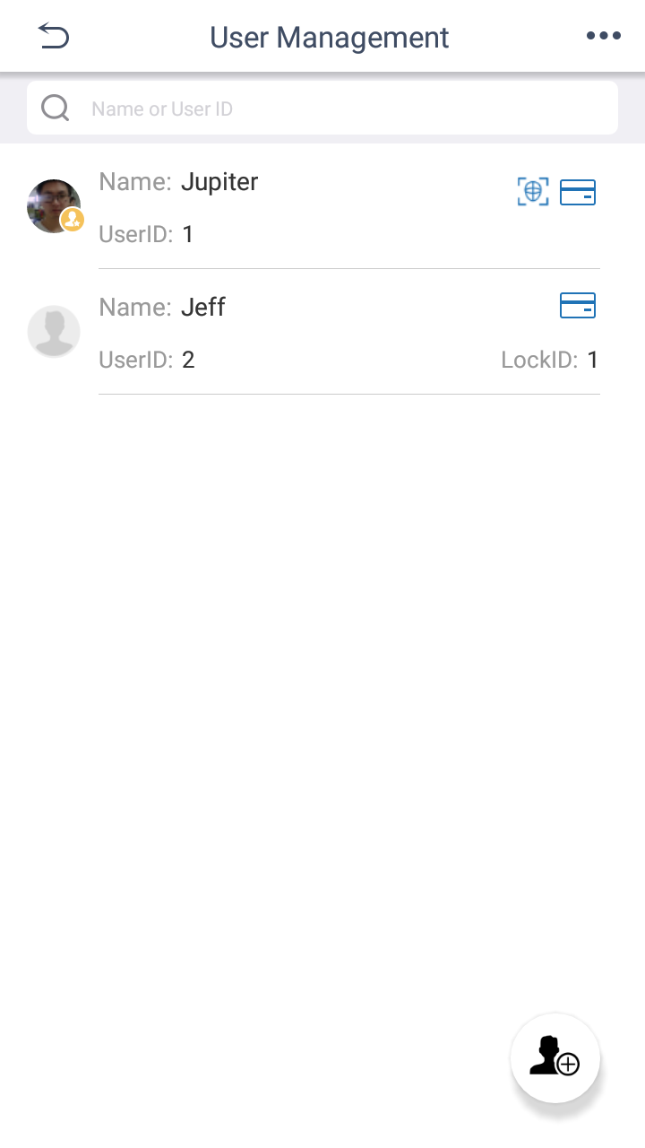
Software Introduction
Home
Facial Recognition
Settings
User Management

Slide 15


Storage and Pick-up
The solution serves regular users, such as employees and residents, and temporary users like visitors and tourists.
Regular Users
Regular users use a certain compartment through facial recognition or RFID card authentication.
Temporary Users
Temporary user use a random remaining/available compartment offering face verification.
That needs the administrator open the configuration switch

Slide 16
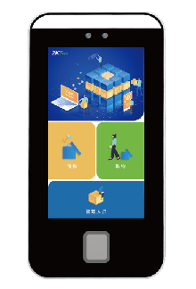

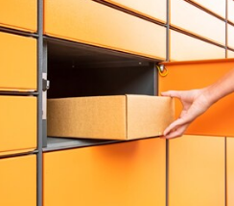
Operation Process
Storage:
Click Storage
Face Registration
The Locker is opened.
Pick-up:
Click Pick-up
Facial Recognition
The Locker is opened.

Slide 17
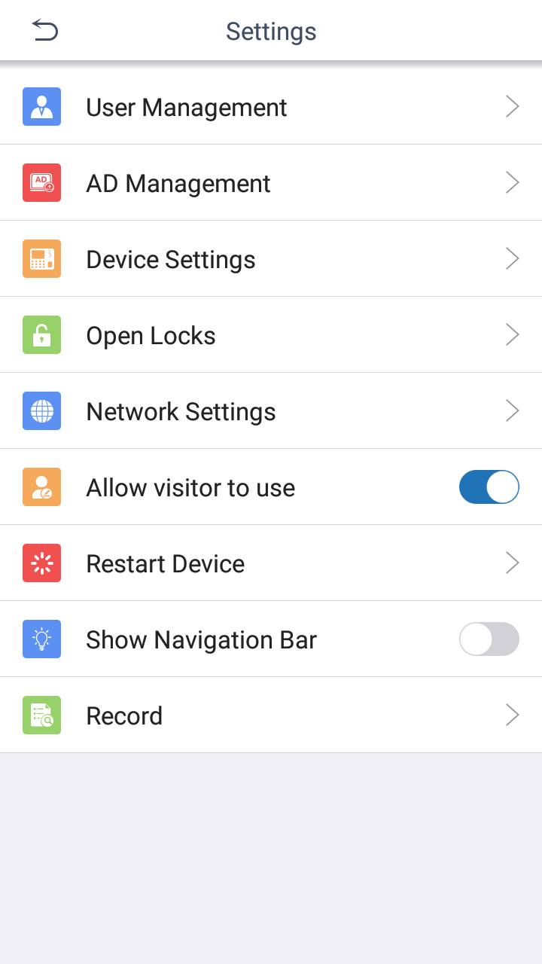
Settings
1
2
3
User management
AD Management
Device Settings
Unlocking the locks
Record
4
5

Slide 18
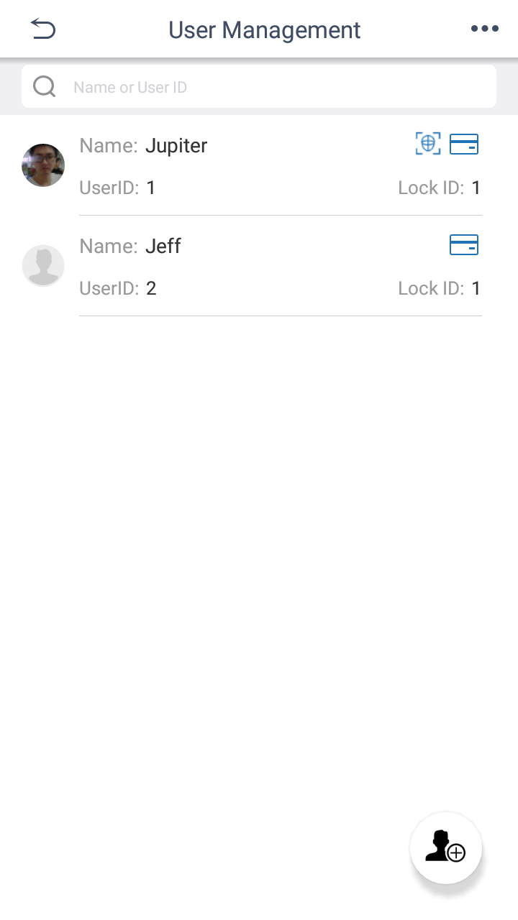
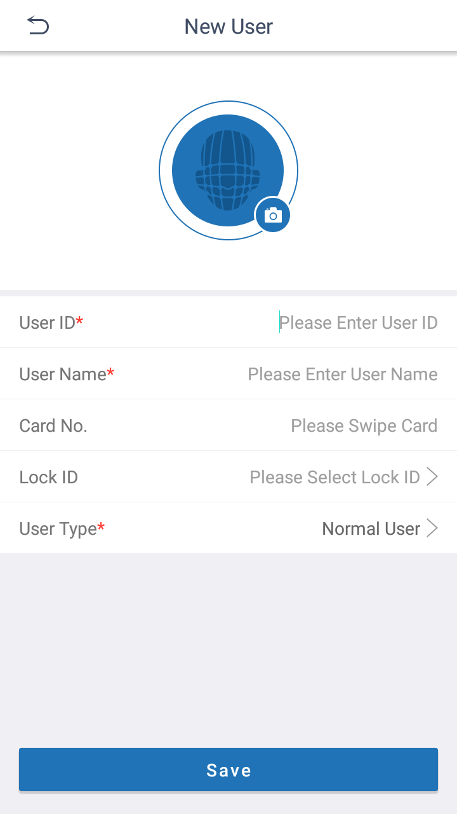
User Management
User ID
User Name
Card No
Lock ID
User Type: Normal User and Administrator

Slide 19
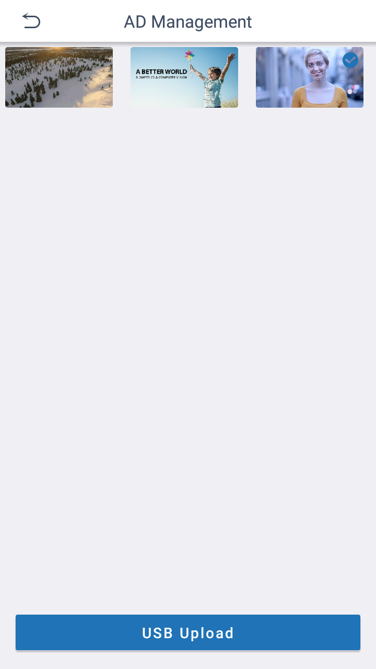


AD Management
The software supports pictures and videos mixed playback, each picture is displayed for 5 seconds.
It is perfectly compatible with 16:9 picture or video advertisements.

Slide 20
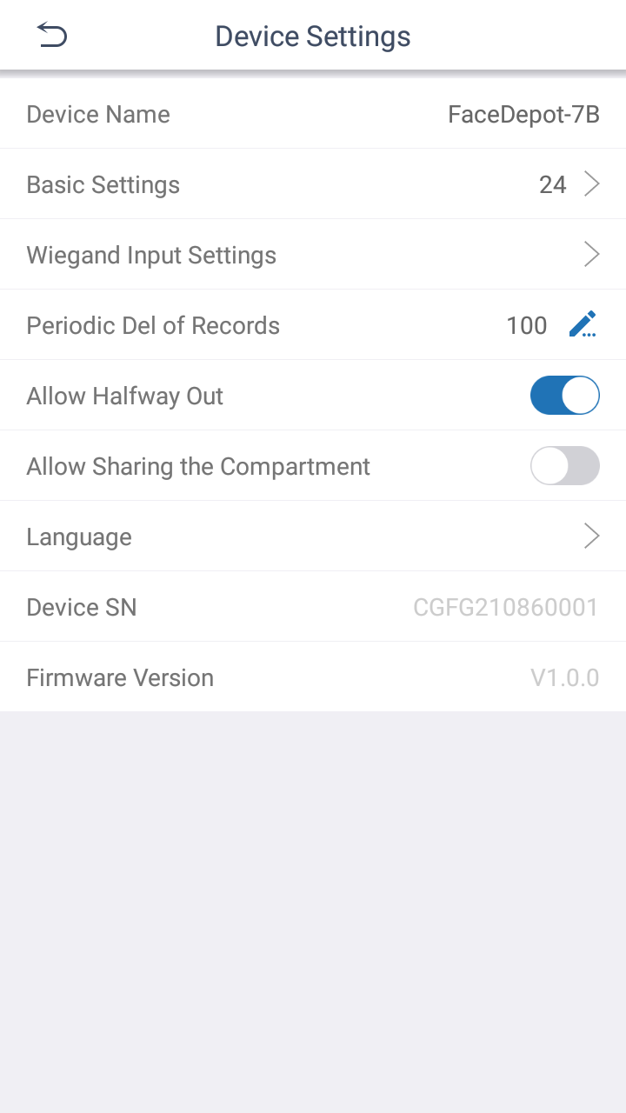
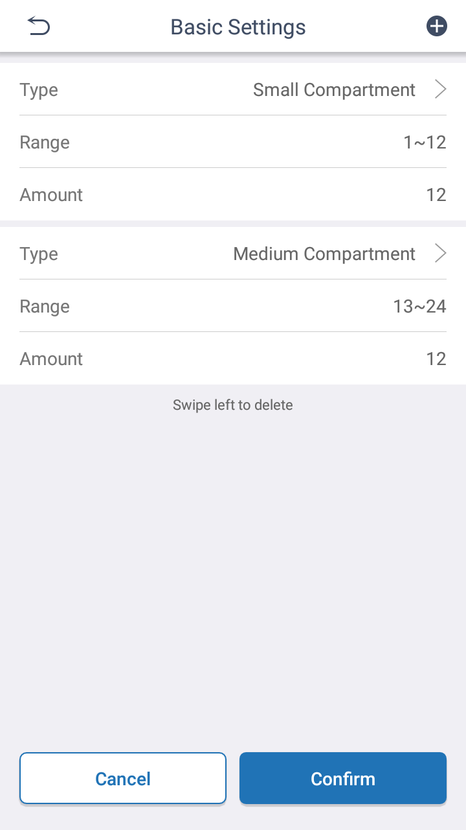
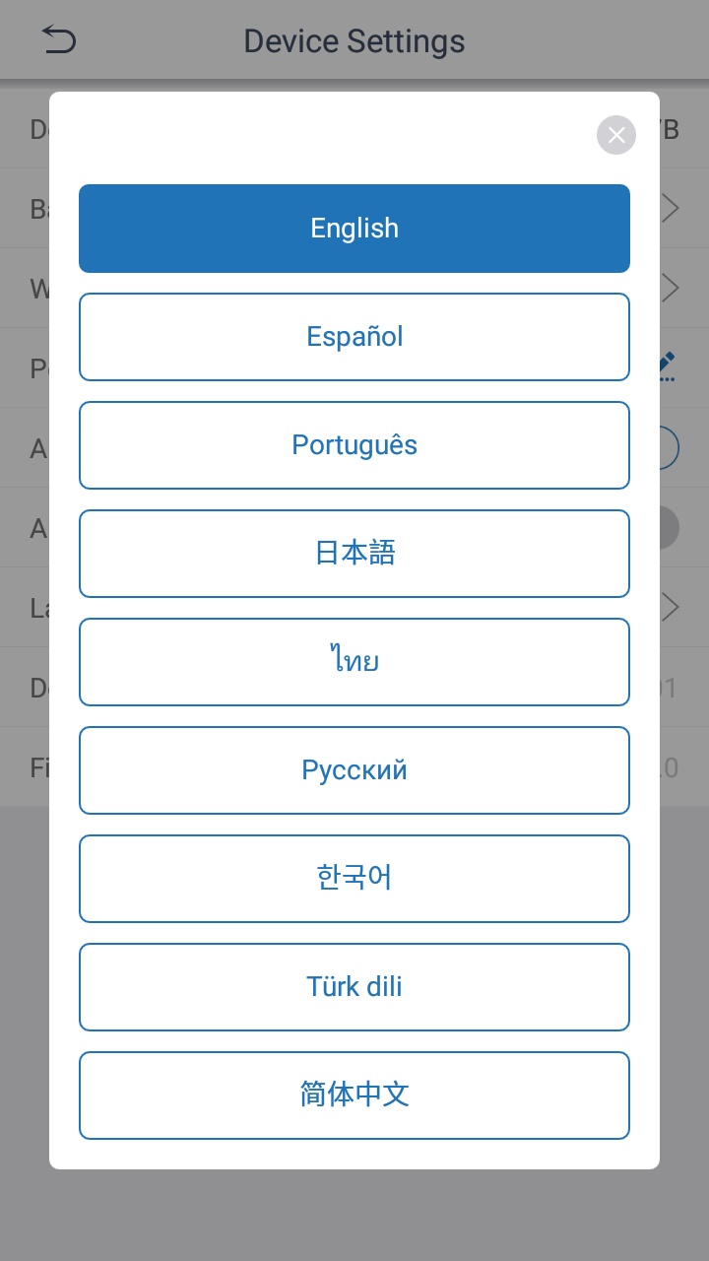
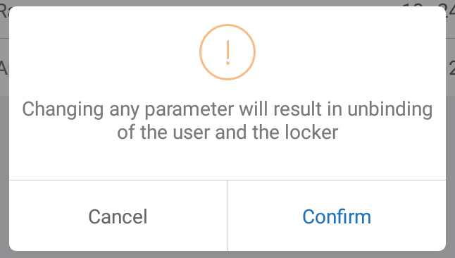
Device Settings
Basic Setting
Wiegand Input Settings
Allow Halfway Out
Allow Sharing the Compartment
Language

Slide 21
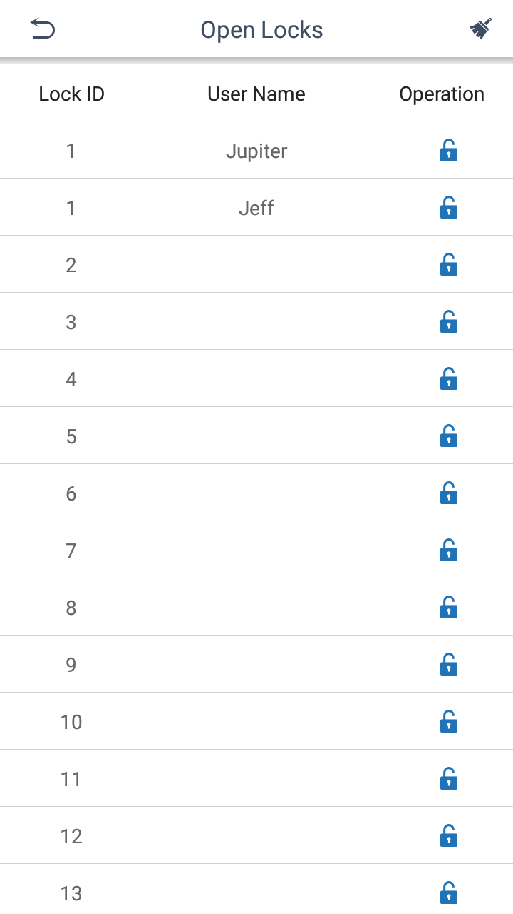
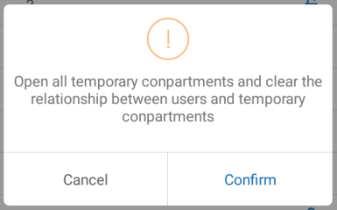
Unlocking
Unlocking: Open the particular compartment
Clear the Locker：Clear the temporary relationship between the user and lock, while open the temporay used compartment

Slide 22
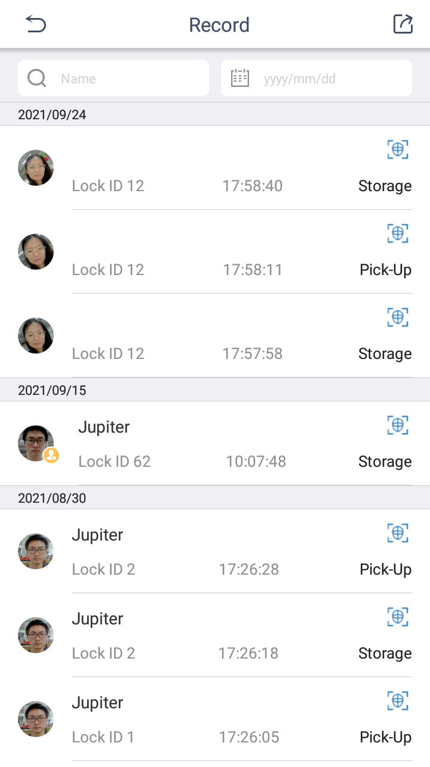
Record
User Name
Lock ID
Operation time
Storage or Pick-up
Verification method
Face Capture

Slide 23
FAQ
3
1. Do we provide locker cabinets from China?
Not yet, we take into account the freight, packaging, delivery, after-sales, added value and other factors, there is no plan to do the locker body, please contact the local locker supplier to provide
2. How is the locker compartment assigned?
For the user who has bound a compartment, he will be fixed to user it indepedently; For the user who has not bound a compartment, the system will randomly assign one of the remaining unbound and unused compartment for him to use.
3. How long is the user's usage time?
No usage time is currently set, so the user's relationship with the compartment will not be automatically cleared， unless the administrator performs the locker clearing operation.
4. Is there softeware to management the locker system?
Currently there is no supporting software, if the project needs software management, we can provide software customization services to achieve.

Slide 24
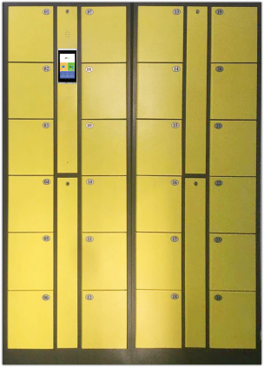
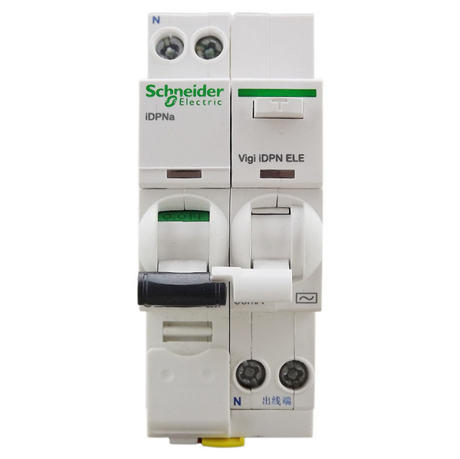
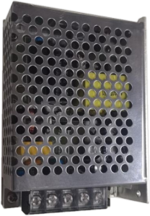
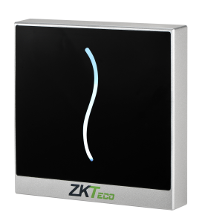
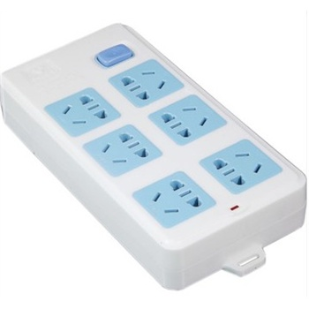
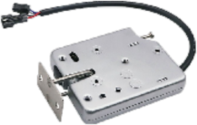
BOM
Model | LockerPad-7B | Car Reader ProID20 BE | Lock Control Board | Switching Power Supply ZKPSM050 (12V/5A) | Lock ECL02 | Locker body | Air Switch | Extension Socket
Photo
ERP Code | F23080036 | A34020106 | A34220115 | A17010133 | X00404001 | N/A | N/A | N/A
Dimensions W*H*D (mm) | 113*210*22 | 90*90*16 | 46*165*11 | 78*100*36 | 59*13*72 | N/A | N/A | N/A
Provider | ZKTeco | ZKTeco | ZKTeco | ZKTeco / Customer | ZKTeco / Customer | Customer | Customer | Customer
Name rule: ProID 20 WE-RS
1
Color: W: White in color; B: Black in color
2
Card type: E: EM; M: Mifare; D: Desfire
1
2
3
2
3
Communication: RS: RS485 communication; if is blank, it means the device uses Wiegand
3

Slide 25

Contact us
ZKTeco Industrial Park, No.32, Pingshan Industrial Avenue, Tangxia Town, Dongguan, China
Tel: +86 17606806530
Email: jupiter.guo@zkteco.com
www.zkteco.com

